Slide 1
User Profiling from Restaurant Text Reviews
Detecting latent user’s properties from review text for Recommendation System
L715/B659 Final Project

Slide 2
Overview
User profiling from restaurant text reviews
Topic modelling (LDA) to find topic distributions for each user
Measure similarity between users
Restaurants recommendation

Slide 3

Data Set
Yelp Challenge Dataset
Select only reviews for restaurants in AZ
Select users with more than 50 reviews
769 users
14,304 businesses
74,832 reviews
Keep only positive reviews
Split data into training and validation set for each user (70:30)
Each document represents texts for a user

Slide 4
Implementation
Pre-processing
Train LDA model with different number of topics (k)
Evaluate perplexity on validation set
Select a set of best k values and train the model with all documents
Visualize word cloud in each topic
Calculate similarity score between users

Slide 5
Tools and Library
Pandas – Python Data Analysis Library
NLTK – Natural Language Toolkit
Gensim – Topic modelling library
Numpy, Scipy – Scientific computing library
Matplotlib – Plotting library
Word cloud – Word cloud generator

Slide 6
Pre-process
Tokenization
Remove stop words
Remove punctuation
Remove word with length <= 3
Lemmatize word
Remove extreme words
Appear in less than 5 documents
Appear in more than 70% of documents

Slide 7
LDA Topic Modelling
769 documents (users)
16,218 unique tokens
k = [20,400,20]
20 iterations in Batch training
Evaluate perplexity on validation set
Select a set of best k and train the model with all data
Notes:
It’s not clear what is the best k value from this graph. Theoretically, it should be the peak of the graph before it drops but there are many local maximum.
Also, perplexity is sometime not correlated with human judgement.

Slide 8
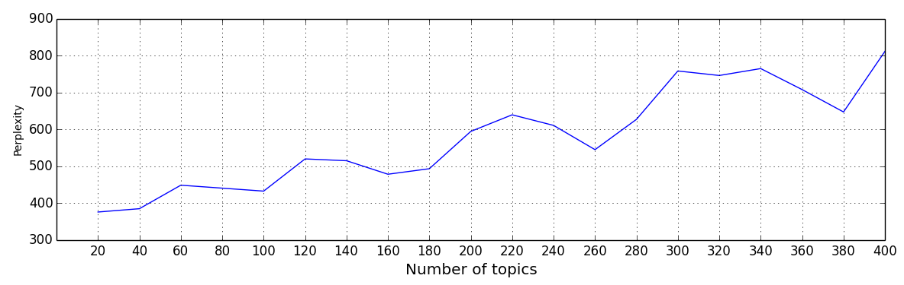
Perplexity
K = 60, 120, 220, 340
Notes:
It’s not clear what is the best k value from this graph. Theoretically, it should be the peak of the graph before it drops but there are many local maximum.
Also, perplexity is sometime not correlated with human judgement.
It took around 2-3 hours to run all this. It’s a time-consuming method even with a small corpus.

Slide 9
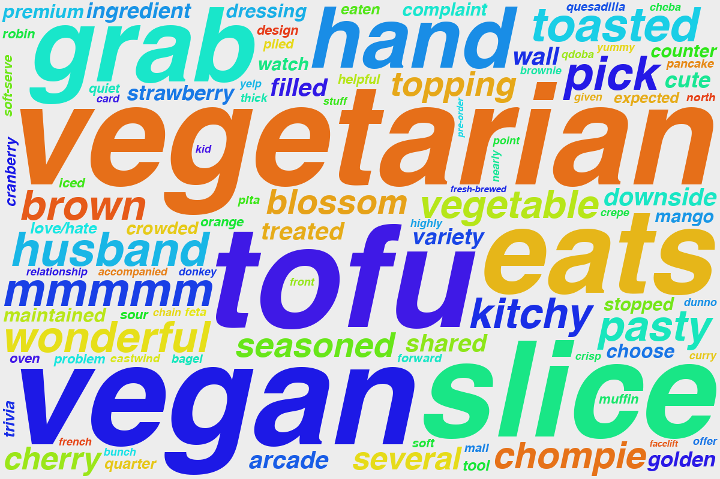
120 Topics

Slide 10
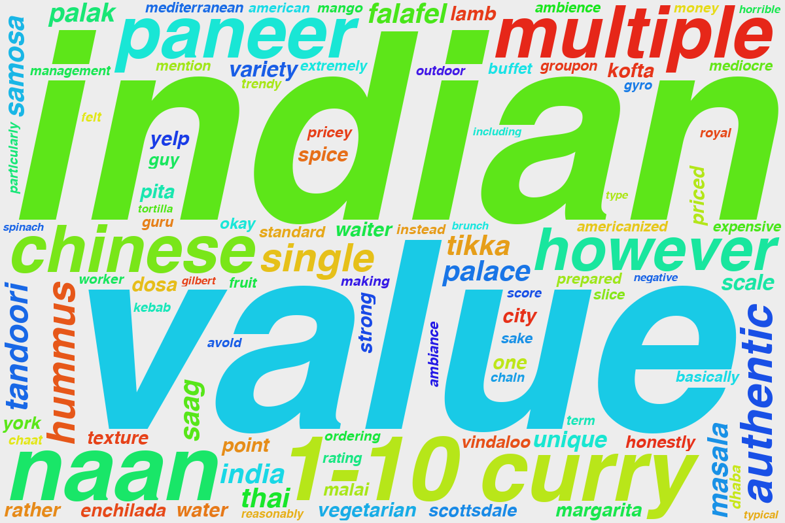

Slide 11
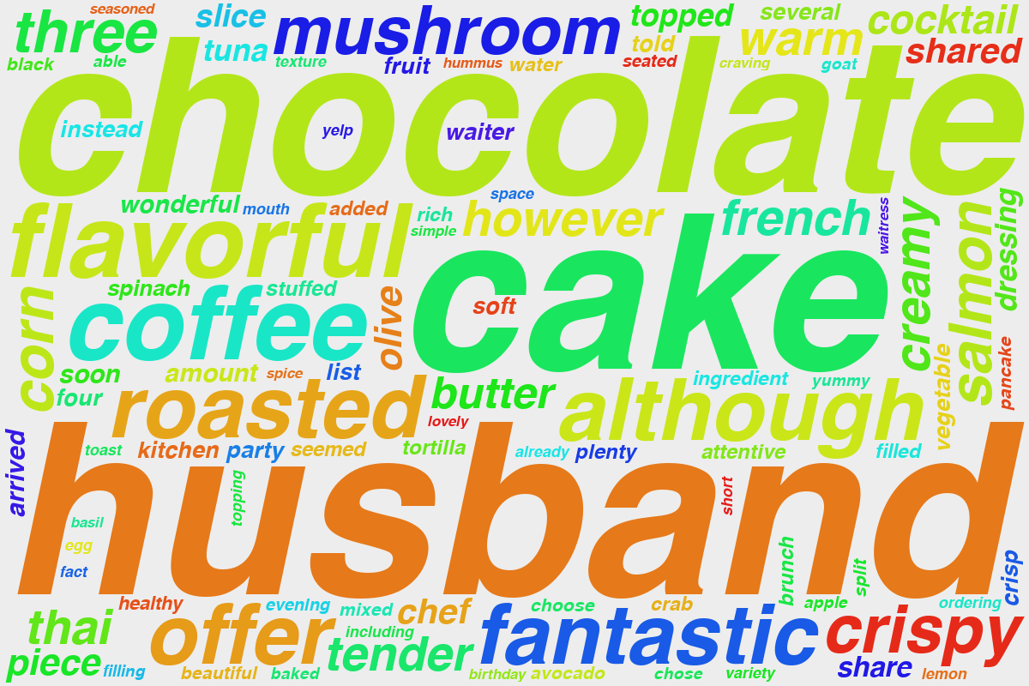

Slide 12
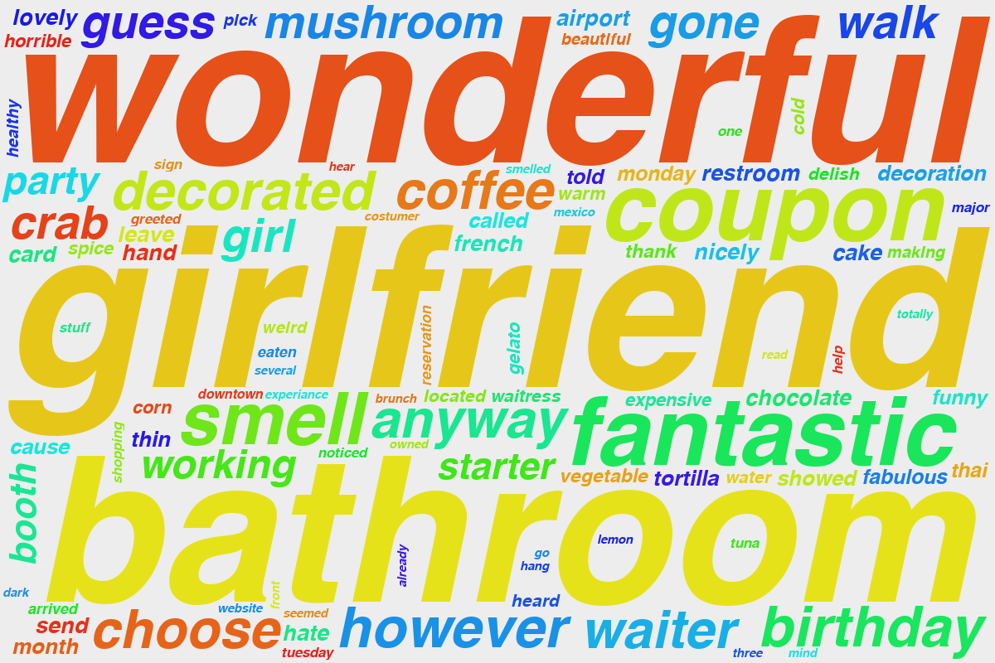

Slide 13
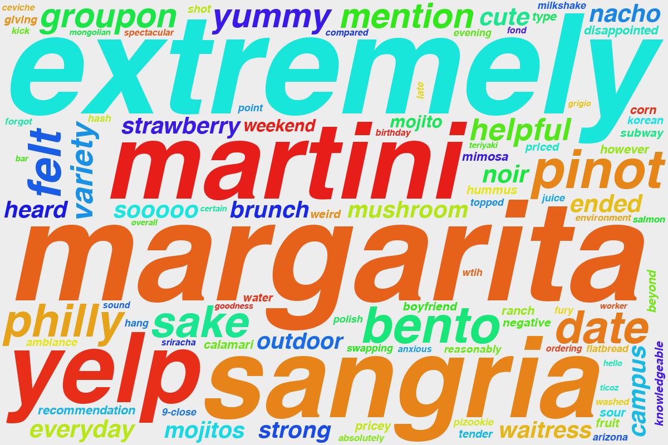
340 Topics

Slide 14
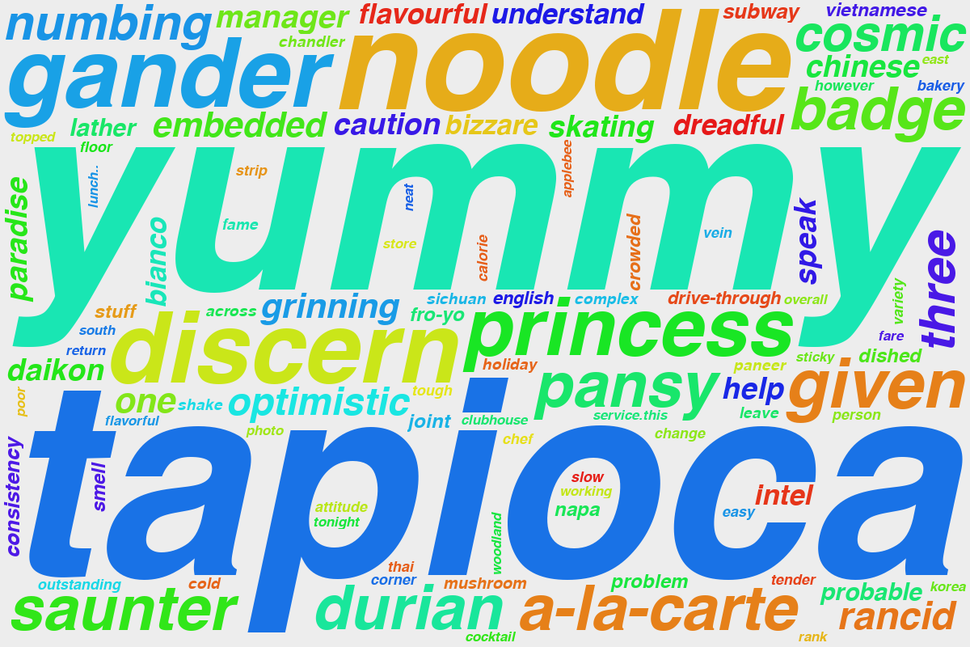

Slide 15
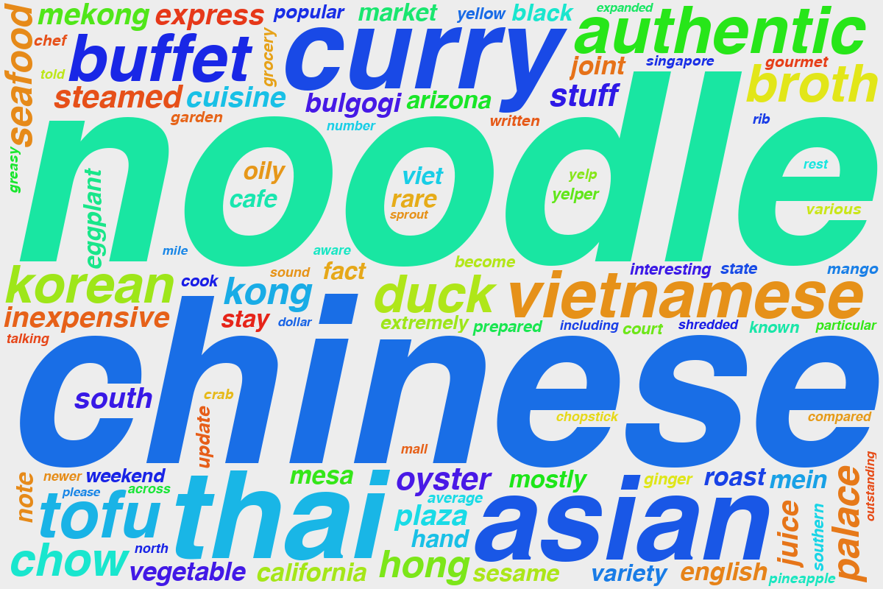

Slide 16
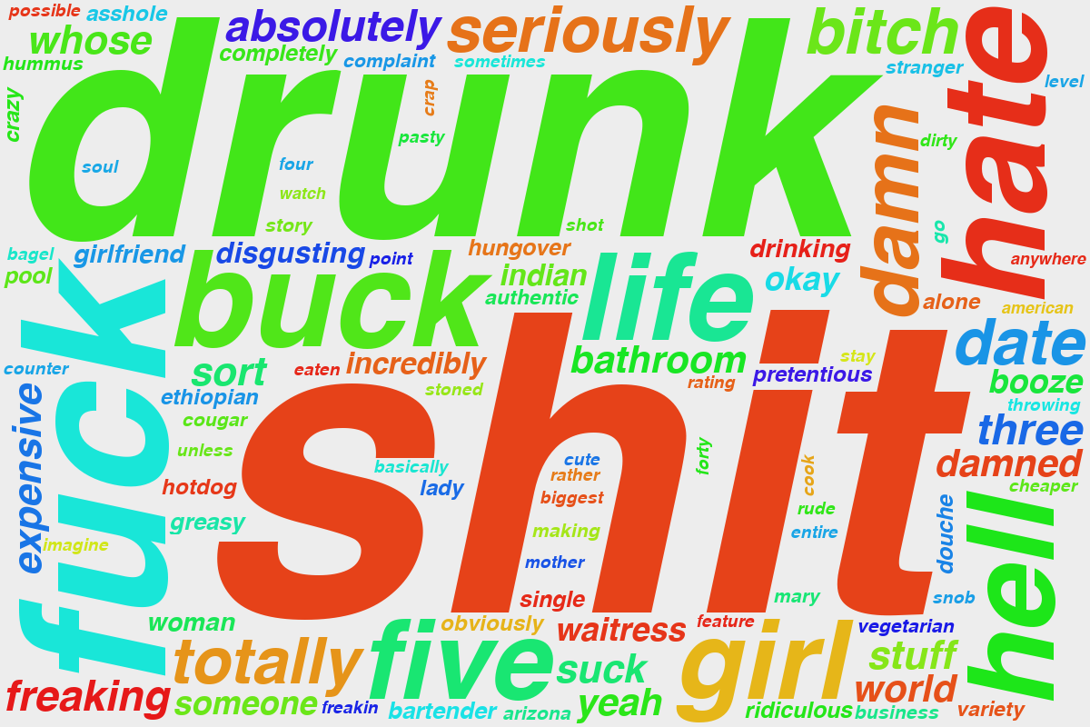

Slide 17
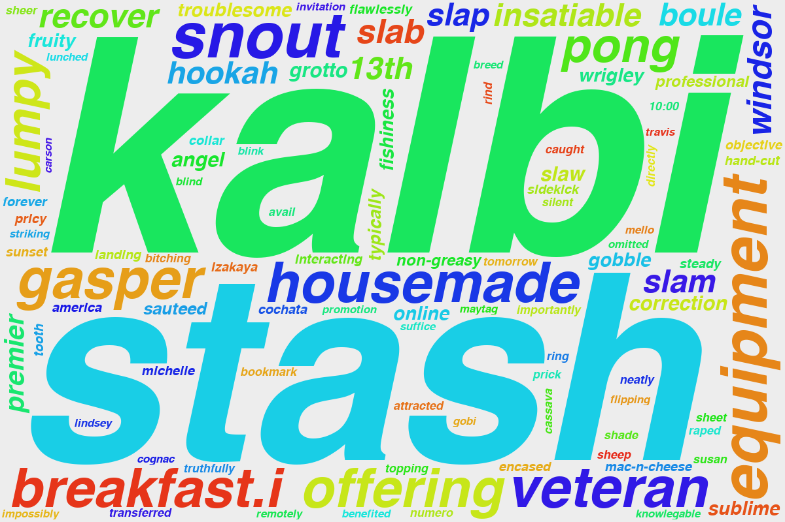

Slide 18
Evaluation
Calculate similarity scores between documents
Cosine similarity
KL Divergence (in-progress)
Select top 5 most similar users for each user
Number of common restaurants
The highest number of restaurants in common is less than 40%
Pearson Correlation for review ratings
A pair of users with more than 10 restaurant reviews in common and score above 0.7
16 pairs for k = 60 (~600 pairs)
15 pairs for k = 340 (~620 pairs)
Notes:
Total of ~36xx pairs

Slide 19
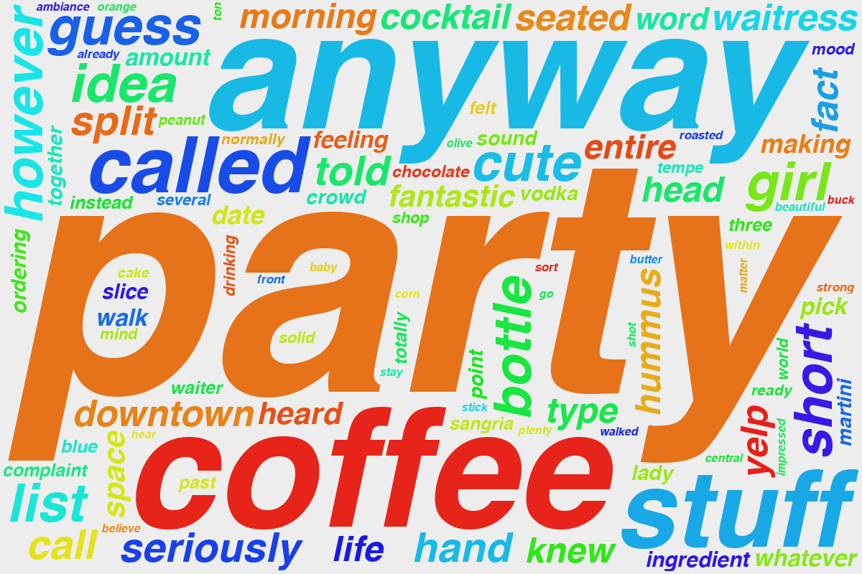
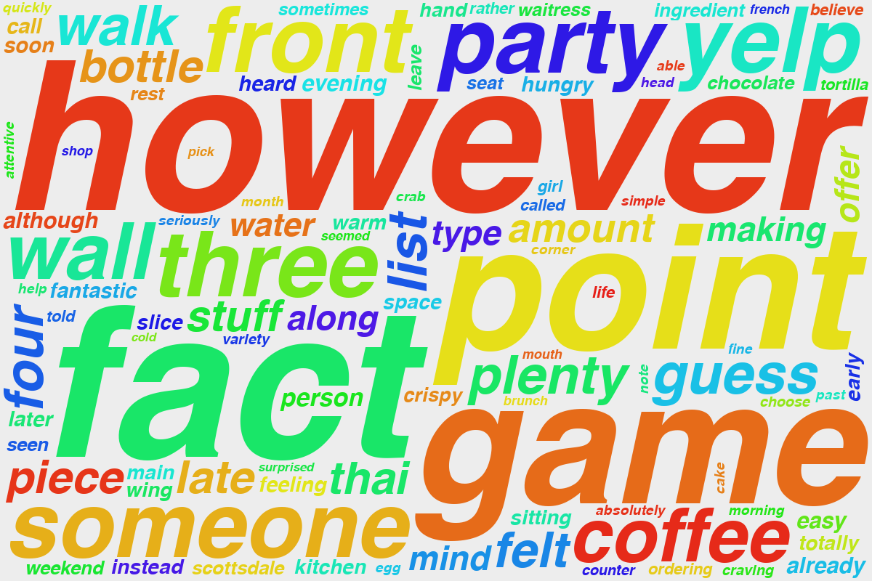
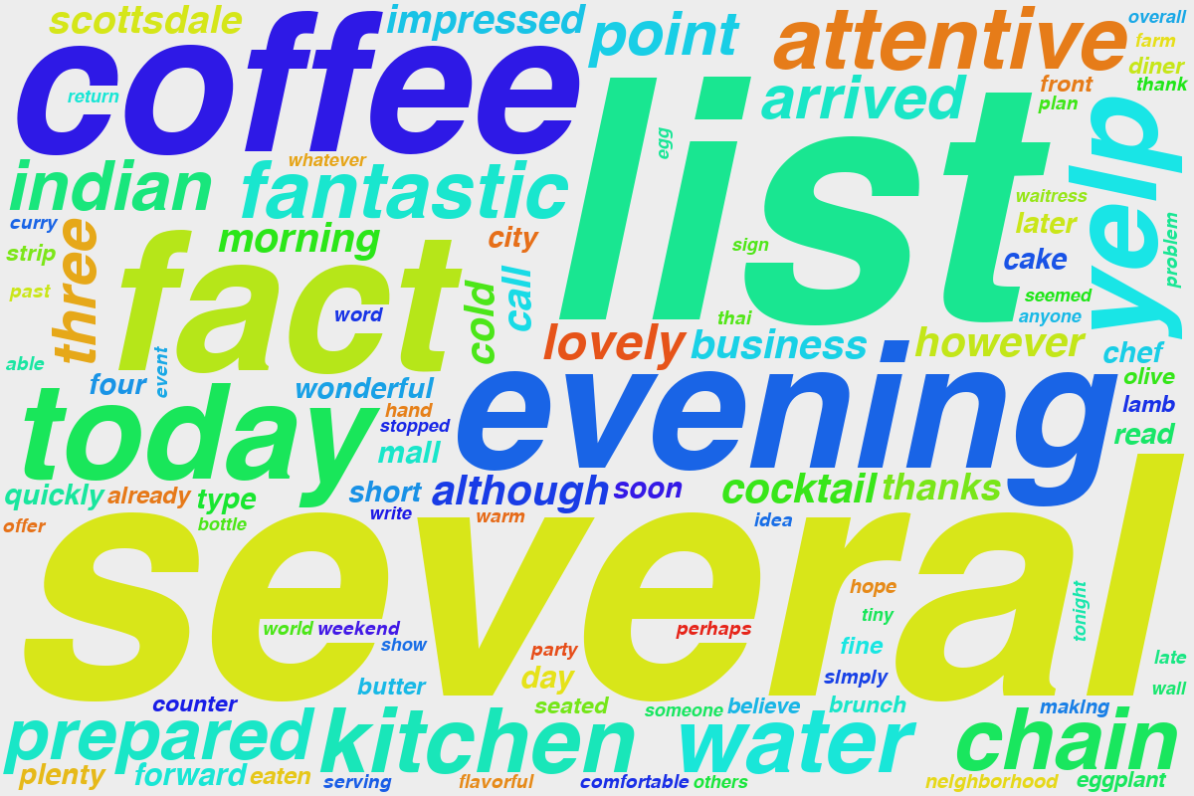
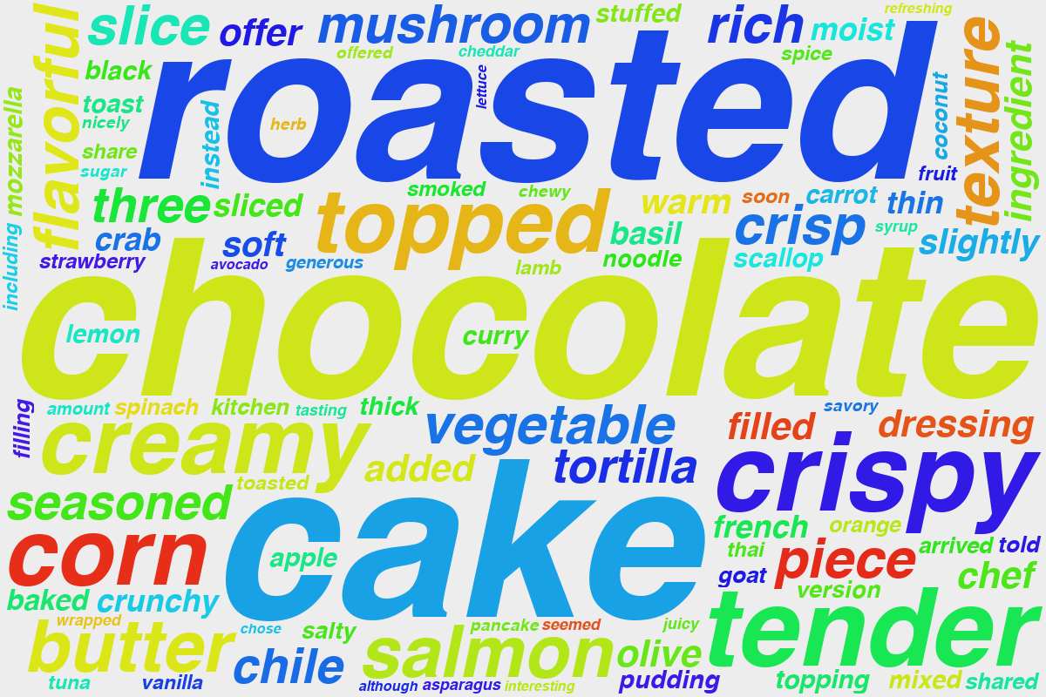
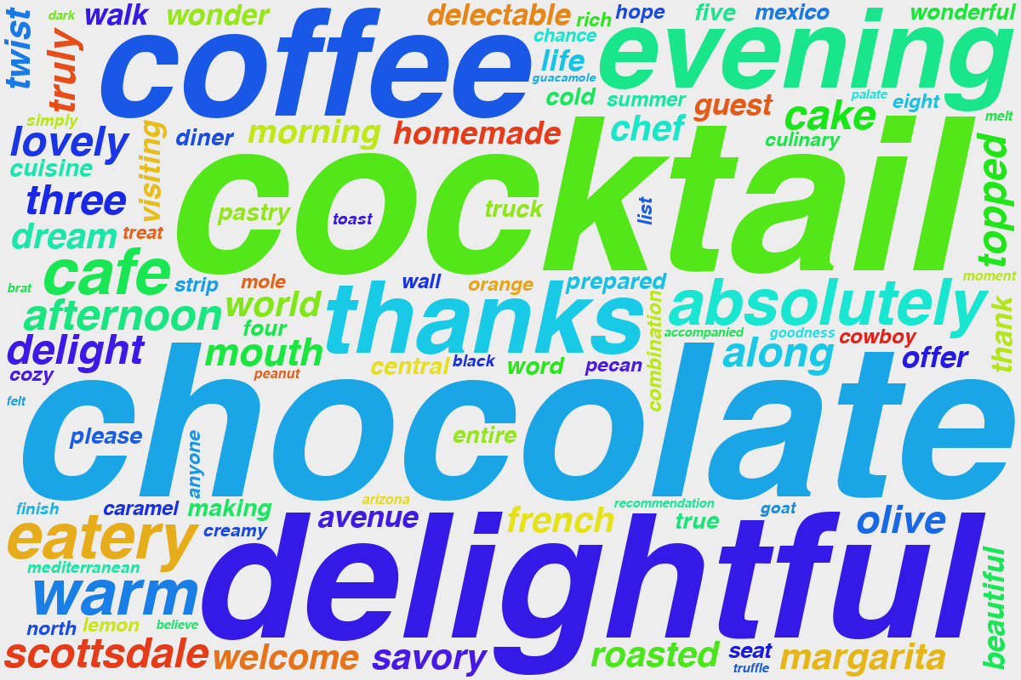
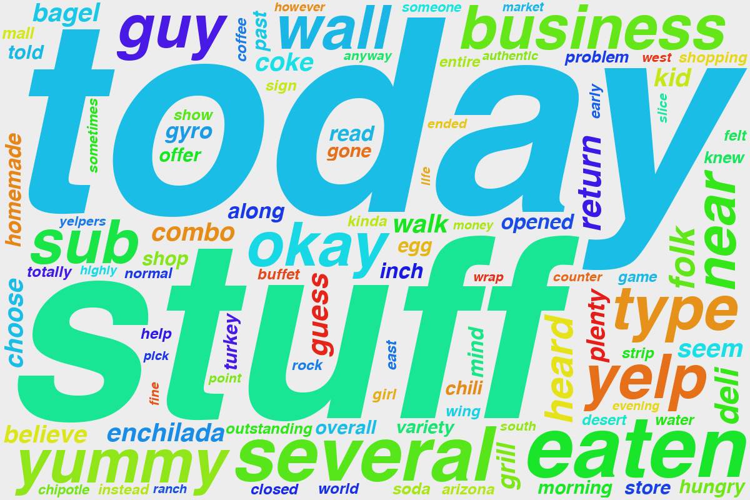
340 topics
4lkTIhTuMhLprQprGlTRlA (70) , nc3cqVN0UuB3m50-CcMftw (142)
16 restaurants in common
0.98564285 similarity score
0.900600016 correlation score

Slide 20
Conclusion
Hard to determine training parameters
Number of topics (k)
Number of iterations (i)
Require human judgement for selecting topics
Hard to evaluate results
Stopwords list is very important!
Time consuming process
Notes:
Difficulties
Determine number of k-topic
Evaluation of results
Manual judgement of topic
Stopwords lists is very important
Time consuming

